Slide 1

Visión por Computador
Domingo Mery
Departmento de Ciencia de la Computación
Escuela de Ingeniería
Universidad Católica de Chile
Deep Face - VGG

Slide 2
Deep Face Recognition
Parkhi, Omkar M., Andrea Vedaldi, and Andrew Zisserman. "Deep Face Recognition." BMVC. Vol. 1. No. 3. 2015.
http://www.robots.ox.ac.uk:5000/~vgg/publications/2015/Parkhi15/parkhi15.pdf

Slide 3
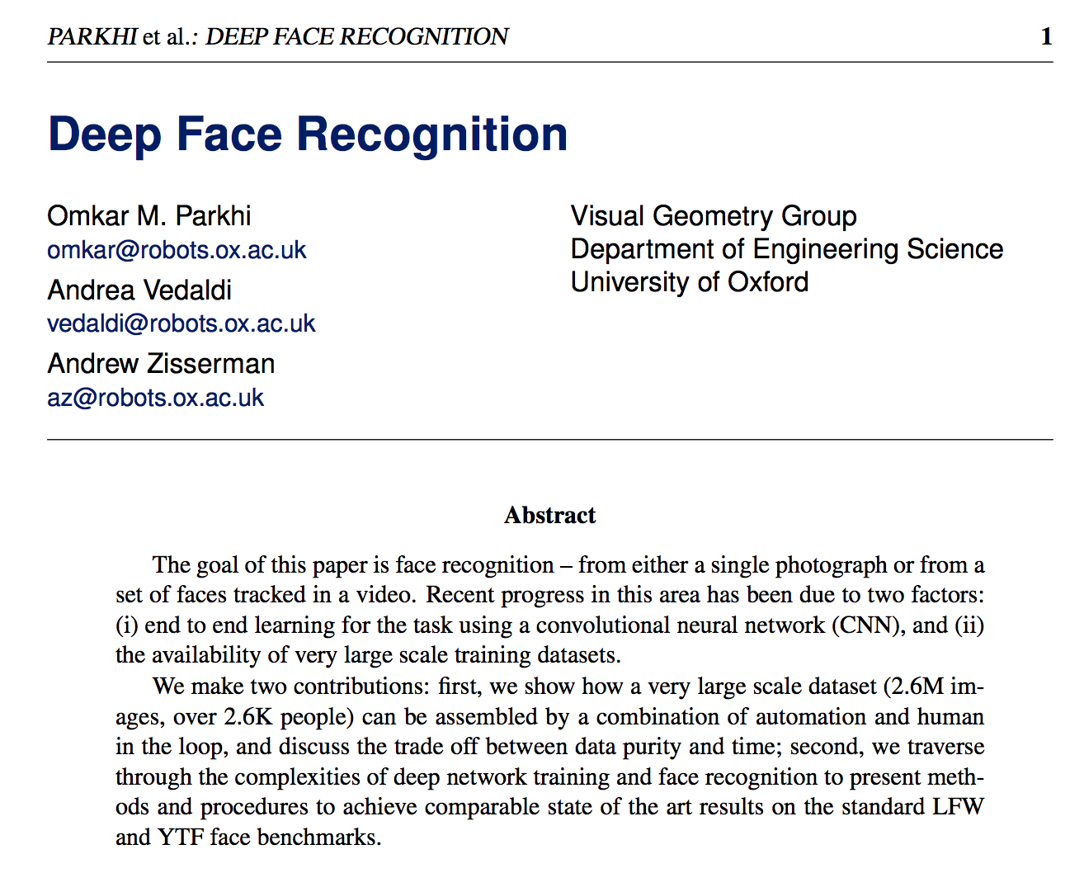

Slide 4
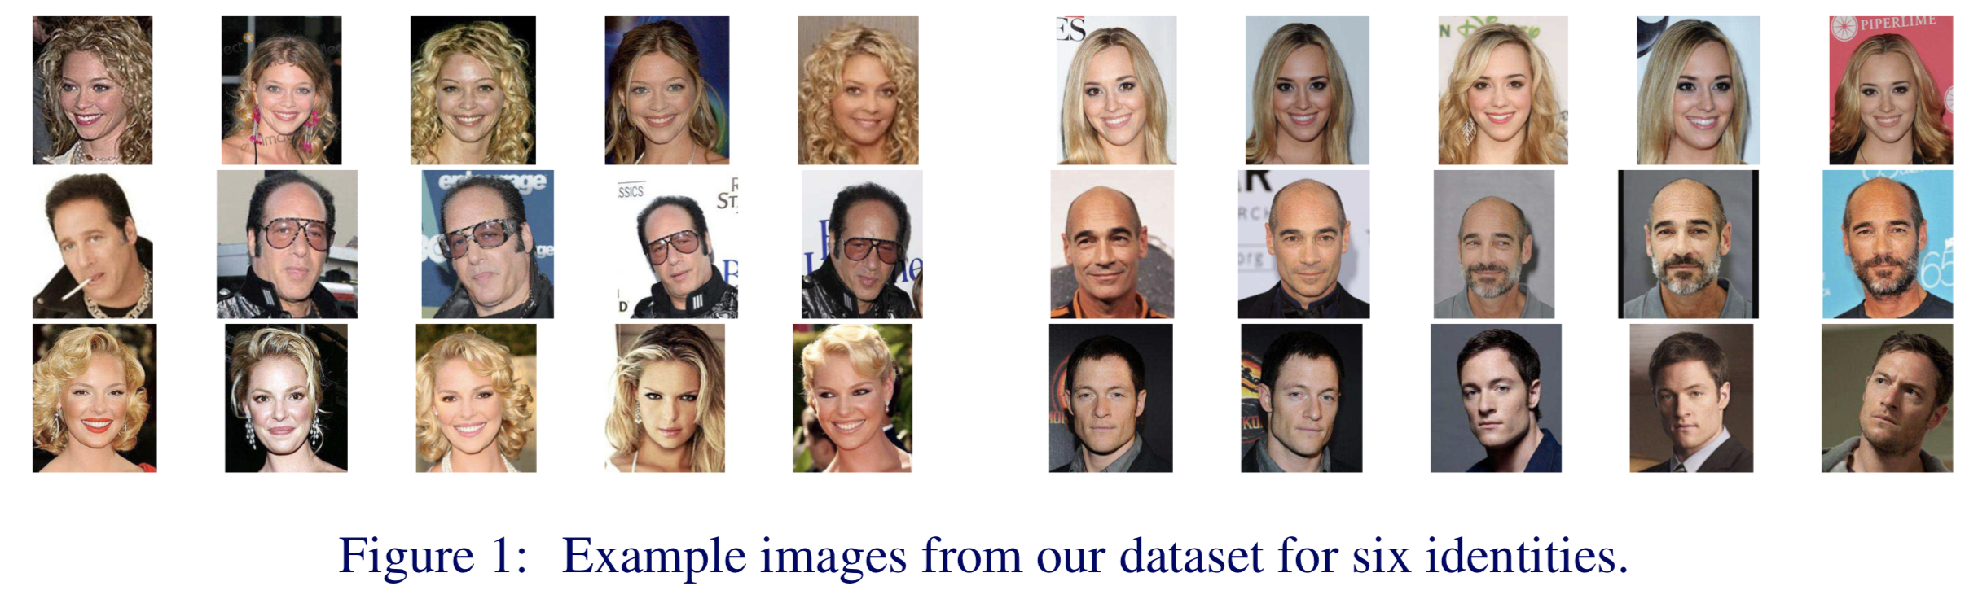
2.622 celebrities and 2.000 face images per celebrity

Slide 5
VGG-Face Architecture

Slide 6
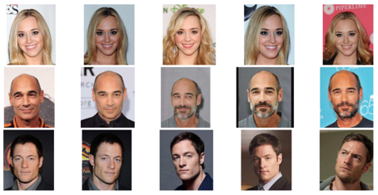
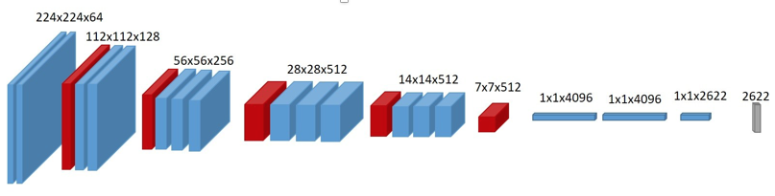


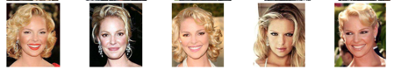
Training: 2.622 class-problem
errors
Class 1
Class 2
Class 3
:
Class 2.622

Slide 7
Verification: We take a part of the trained model
VGG-Face trained model

Slide 8
Verification: We take a part of the trained model
VGG-Face trained model

Slide 9
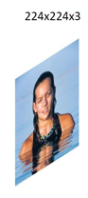

Verification: The model is used for feature extraction
OUTPUT:
4096-element
descriptor
INPUT: Face Image
(this person was not
in the training set)
VGG-Face trained model
A face image is represented as a 4096-element descriptor.
Descriptors form same/different person are similar/different.

Slide 10
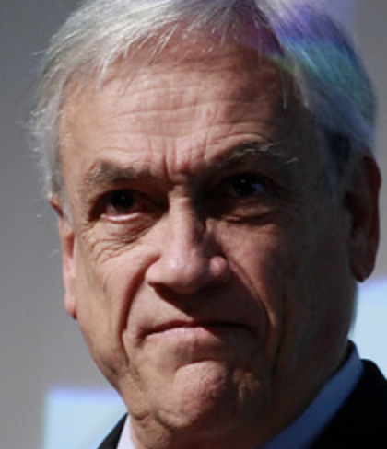
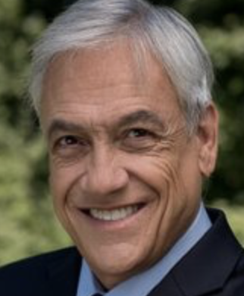
Verification: Comparison of two face images
-
LOW
Descriptors form same person are similar.

Slide 11
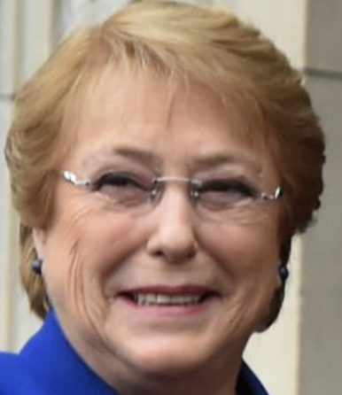

Verification: Comparison of two face images
-
LOW
Descriptors form same person are similar.

Slide 12
Verification: Comparison of two face images
-
HIGH
Descriptors form different persons are different.

